Slide 1
Robert’s Rules Demystified
Robert’s Rules?
Notes:
Robert’s Rules Demystified
Northern Missouri District December 2021
Dr. M. Ray Brewer
Who is Robert? And who decided that he gets to rule? ~smile~

Slide 2
Talking Points
History of Robert’s Rules Of Order
Components of Robert's Rules
Motions and Voting
Final Words

Slide 3
History
and
Purpose

Slide 4
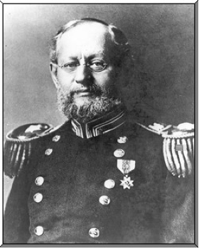
Who was Robert?
Army Major Henry Martyn Robert had bad experiences leading church meetings, so he decided to develop an organized and democratic method of conducting meetings.
The result was writing a
Pocket Manual of Rules of Order for Deliberative Assemblies,
first published in 1876.

Slide 5
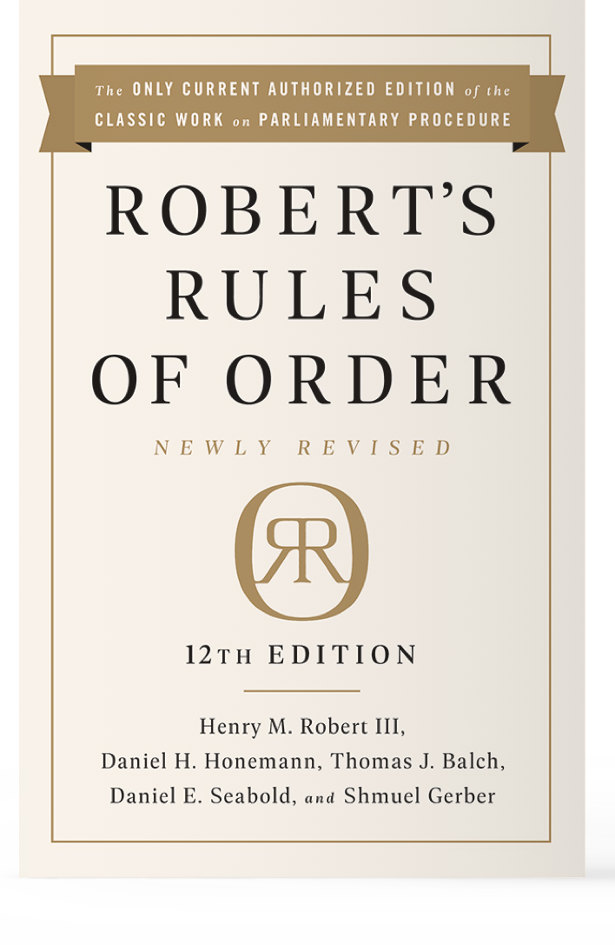
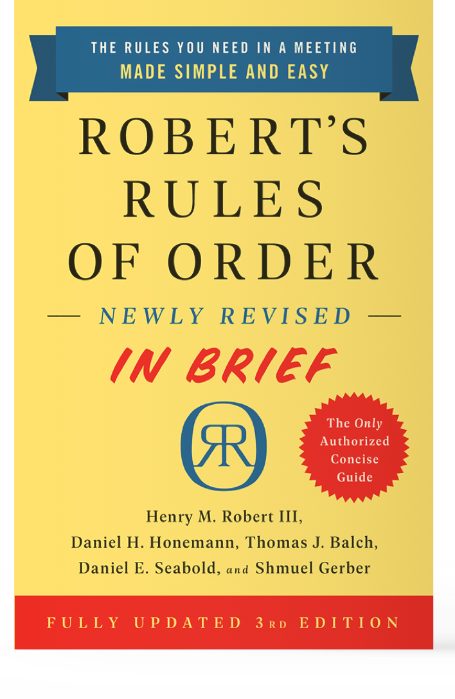
Official Robert’s Rules Books
816 pages
224 pages
There are TWO official books
Notes:
Talking points:
Brief 224 pages
The long version has 816 pages

Slide 6
Official Robert’s Rules Books
You don’t need to read them devotionally!
It’s really, really boring!
Notes:
Talking points:
How many pages in your Bible?
Read it devotionally, because it is really, really life-giving!

Slide 7
What are the parliamentary procedures?
They are rules for conduct at meetings that allow everyone to be heard and to make decisions without confusion.
RULES

Slide 8
What are the parliamentary procedures?
They are rules for conduct at meetings that allow everyone to be heard and to make decisions without confusion.
“Take me out to the ball game, take me out with the crowd…”
RULES
Notes:
Robert’s idea was a set of rules that anyone could use for a business meeting.
He compared it to baseball. Everyone knows the basic rules and how to play the game.

Slide 9
Why use Robert’s Rules Of Order?
Benefits:
80% of all organizations use Robert’s Rules as their parliamentary procedures.
The rules help maintain order and guarantee impartiality.
Robert's Rules put you in greater control and allow you to consider all points of view.
Poorly facilitated meetings result in:
frustration
waste of time
fear of attending meetings
low attendance

Slide 10
We Don’t Need Robert’s Rules
Biblical Leadership (www.biblicalleadership.com)
“Three Reasons to Kick Robert’s Rules
Out of Your Church”
1. Robert’s rules are not consistent with the New Testament leadership pattern.
2. Robert’s rules are not consistent with a Biblical philosophy of leadership
3. Robert’s rules open the door for ungodly, rebellious behaviors
Notes:
Really? Biblical Leadership’s arguments?
BL: “Congregational church government allows members to make a motion in flagrant opposition to the will of the God-appointed leaders. If one consistently follows Robert’s Rules (which most churches don’t), this is a possibility.”
BL: “God chooses leaders, not members. They shouldn’t vote on the leaders.”
BL: “Leaders lead and followers follow. Followers who don’t follow are rebels. Those who publicly defy their leaders are swallowed up by the ground, turned into lepers, and bitten by snakes. We should not encourage God’s people to do wrong by handling them copies of Robert’s Rules.”

Slide 11
Components
of
Robert’s Rules

Slide 12
Order of Business: Agenda
Call Meeting to Order
Roll Call of Members
Call for Addition/Deletions of Agenda Items
Reading and Approval of Minutes
Reports of Officers, Standing and Special Meetings
Unfinished Business and General Orders
New Business
Adjournment

Slide 13
Quorum
Quorum - The number of members that MUST be present in order to legally proceed with the business meeting.
Why? Because we don’t want small groups to represent all members, making decisions that will affect EVERYONE.
Notes:
Know your church's quorum?
Must it be maintained? Yes. Chair or member may call this to attention.

Slide 14
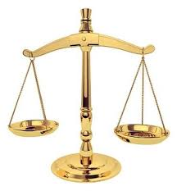
6 Basic Rules
The rights of the organization replace the rights of individual members.
A quorum must be present to do business.
The majority rules.
Silence is consent.
Motions must receive full debate.
One speaker and one question at a time.

Slide 15
The Rights of the Minority
The right to hear the voice of those who oppose
The right to have the comment of the opposition recorded in the minutes
Once the opposition's voice is heard and voted on, the decision that is made is the decision of the whole group, including those who oppose.

Slide 16
Appropriate Meeting Conduct
Always use the microphone (if provided).
Remain quiet while others are speaking.
Address the chair and avoid names.
Notes:
Address the chair, not the congregation.
Avoid names, use “previous speaker” or something similar.

Slide 17
Member’s Rights
1
Receive meeting notifications and attend all meetings
2
Make motions / second motions
3
Contribute to the discussion about the agenda after requesting permission from the chair
4
Vote

Slide 18
Motions
and
Voting

Slide 19
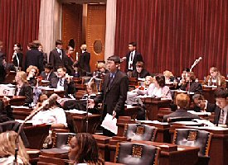
What is a Motion?
A motion is made to introduce items to the membership for their consideration and to make a recommendation to act upon it.

Slide 20
The right to make a Motion
Items of business are considered one at a time.
For the motion to proceed, it must be directly related to the issue being considered.
Frivolous, vague, incoherent and repetitive motions are out of order and are not moved forward.
The person making the motion has the right to first speak about the motion.

Slide 21
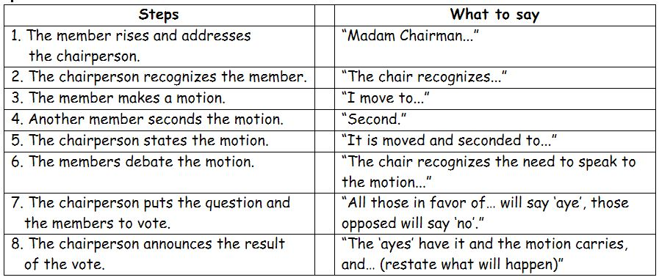
Making & Handling Motions according to Robert’s Rules
8 steps required from start to finish to make a motion and get the group to decide whether it agrees. Each step is a required part of the process.
Notes:
Don’t forget #8! Announce the decision, and restate what the motion does.

Slide 22
The Three Big Motions
Main Motion
I move that Pastor Ray provides ice cream for all the participants in the Robert’s Rules Seminar. Seconded.
Motion to Amend
I move to amend the motion by specifying that the ice cream is vanilla. “Provide vanilla ice cream…”
I move to amend the amendment by adding two additional flavors, strawberry and chocolate. “Provide vanilla, strawberry, and chocolate ice cream…”
Motion to Amend The Amendment
Notes:
The Big Three—keeping these straight goes a long way in a business meeting.

Slide 23
Subsidiary Motions And Their Rank
Lay on the Table
Previous Question
(call for the vote)
How to handle motions
Limit Debate
Postpone
to a specific time
Commit or Refer
Amend
A Main Motion
Postpone Indefinitely
Notes:
Robert Rules Demystified II will deal with Subsidiary Motions in more detail.
As well as Incidental Motions.

Slide 24
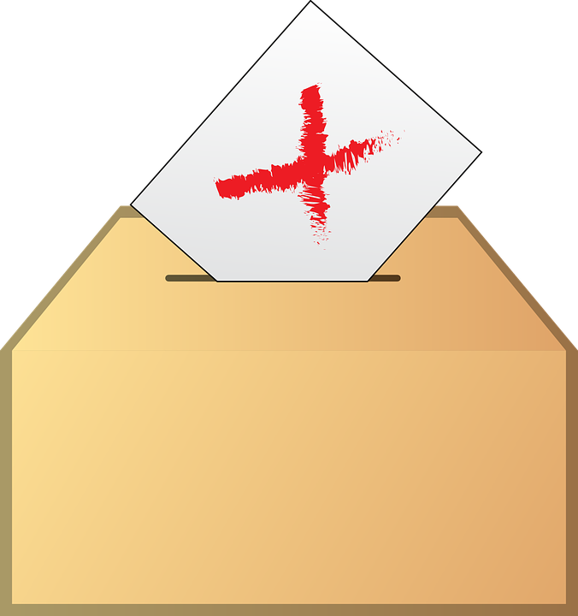
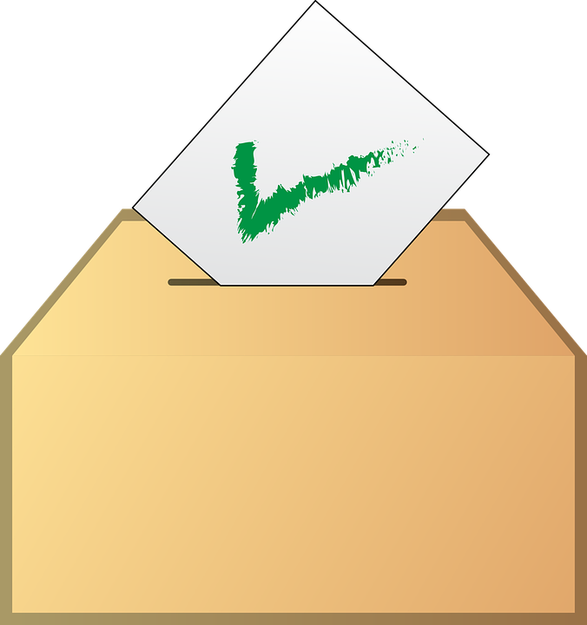
Voting
Ballot vote:
Each person receives a ballot and casts a vote.
Voice vote (or show of hands):
The majority vote rules (Tie vote is a lost vote!)
The chair says the following: “All in favor say “aye.” All opposed say “no.”
“no”
“aye”
Notes:
There are different methods of voting:
Voice Vote – “aye” or “no” (not nay if you want to be a Robert’s Rules snob)
Standing Vote – Show of hands; Chair rules; anyone can challenge, “Division” (no need for second)
Ballot Vote – Secret ballot; anyone can request (no need for second)
General Consent
Absentee Vote
Electronic Vote

Slide 25
What About Absentee Ballots?
Do the Bylaws allow an absentee ballot?
If YES, follow Bylaws.
Note: Absentee ballot only “good” for first ballot.
If NO, follow Bylaws.
If no mention of absentee ballots in Bylaws, discourage absentee ballots (fix your Bylaws?).
(If the Chair decides to allow, ask permission from membership. “I will entertain a motion to allow for the counting of absentee ballots.”)
Notes:
If no, discourage.
If the organization has allowed it in past, ask for a motion to receive absentee ballots.

Slide 26
Reports Do we receive, accept, or adopt a report?

Slide 27
Receiving A Report
A report of an officer or committee is "received" by a board or assembly when it is presented or read.
In other words, the person making the report presents it, while the listeners receive it. As a result, it is incorrect parliamentary practice for a motion to be made at a board or membership meeting to "receive" a report after it is presented, since the act of presenting it constitutes reception by the hearers.
Example. A church treasurer makes a report of the church's finances at a monthly meeting of the church board. Following the presentation of the report, and the treasurer's response to questions and requests for clarification, a board member moves "to receive the treasurer's report with appreciation." This motion is nonsensical, since the treasurer's report was received when it was read.
Notes:
No motion is required. However, no harm, no foul!
Most reports are for informational purposes only and contain no recommendations or motions.
Better response at end of report and questions. “We have received the Treasurer’s report and no motion is required. Let’s show our appreciation for the report.”

Slide 28
Adopting (or Accepting) A Report
Robert’s Rules of Order states that motions to adopt or accept the report of an officer or committee are synonymous, and signify that the entire report becomes “the act or statement of the assembly.”
Such motions have the effect of “the assembly’s endorsing every word of the report, including indicated facts and reasoning, as its own statement.”
Example #1. A church secretary reads the minutes of the previous meeting and someone moves ”to accept the minutes as presented.” This motion is a formal adoption of the minutes. Problem?
Example #2. A church treasurer makes a report of the church's finances at a monthly meeting of the church board. A board member moves "to accept the treasurer's report with appreciation." This motion is also a formal adoption of the financial report. Problem?
Notes:
Many mistakenly believe that ”accepting” a report is not the same as “adopting” a report. They are incorrect. The words are synonymous.
Example #1. No problem. If the minutes accurately portray the previous action of the business meeting, this is fine.
Example #2. Problem. This has the effect of relieving the treasurer of any personal culpability for his or her report (except for fraudulent or illegal activity). Usually the board will wait to pass a motion to adopt/accept the end of the fiscal year report of an CPA firm or internal audit committee.

Slide 29
Tips & Final Thoughts

Slide 30
Tips
1. Educate your leadership in basic Robert’s Rules.
Just the basics, short and sweet
2. Use Robert’s Rules to help people, not rule them.
“Would you like to make that a motion?”
4. Keep it simple; perhaps a PowerPoint chart?
Use Main Motion Chart

Slide 31
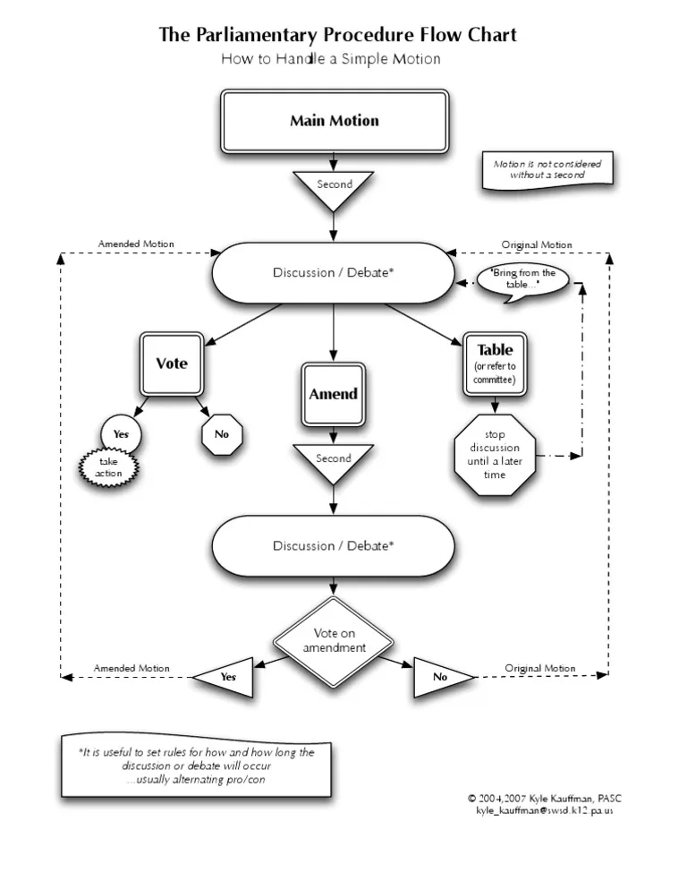
Notes:
Hmmm, not so simple? LOL!
This chart actually leaves out the “amend the amendment” motion.
A subsidiary motion, “Table” is included. There are a few others (Postpone, refer to committee)

Slide 32
Tips
4. Majority, “more than half” (Not 51%!)
50% of 47 = 23.5, “more than half” is 24.
5. 2/3rds vote, “at least 2/3,” must round up fractions;
2/3’s of 100 is 66.66 or 67 votes.
6. Motions, a tie is a loss.
Motion fails; can’t just revote!
7. The Chair, if a member, can vote.
But the Chair doesn’t have to vote.

Slide 33
So, When Might the Chair Vote?
Example 1: Without the chair’s vote, there are 50 votes in the affirmative and 50 votes in the negative.
Unless the chair votes, the motion will not pass. (A tied vote on a motion means the motion fails.)
The chair thinks, “Dessert is pretty important stuff. Anything to do with ice cream, I’m in.”
So, the chair votes yes.
The new totals are 51 votes in the affirmative and 50 in the negative.
The vote passes.

Slide 34
So, When Might the Chair Vote?
Example 2: Without the chair’s vote, there are 51 votes in the affirmative and 50 votes in the negative.
Unless the chair votes, the motion will definitely pass.
The chair thinks, “You know, I’m on a diet and I might be tempted to eat the ice cream. Yep, the temptation is too great.”
So, the chair votes no.
Now the total votes are 51 in the affirmative and 51 in the negative.
Because a tied vote is not a passing vote, the motion fails.

Slide 35
So, When Might the Chair Vote?
Example 3: There are 51 votes in the affirmative and 50 votes in the negative.
Unless the chair votes, the motion will definitely pass.
The chair thinks, “People might judge me if I vote in the negative and deny them some ice cream. I’ll just be quiet.”
So, the chair abstains.
That means the totals don’t change—there are still 51 votes in the affirmative and 50 votes in the negative.
The motion is adopted.

Slide 36
Tips
8. Don’t allow abuse to a motion for the previous question to end debate.
“I move the previous question.”
Sometimes:
“I call for the question.”
“Question!”
“I call for a vote.”
Notes:
Moving the previous question is a motion to end debate on a pending proposal and bring it to an immediate vote.
Chair does not need to act upon shouts of “question” unless the speaker has been recognized and makes it an official motion.
Chair should insure that proper time has been given for debate.
Chair can simply declare that sufficient time has been given for debate and we will now consider the question. Or the Chair can simply declare that insufficient time has been given and continue to recognize individuals wishing to speak.
Motion is not debatable (that would defeat its purpose), and requires a two-thirds vote (because it is ending debate and requiring the organization to vote on the pending question.
If the Motion to “move the previous question” succeeds, the chair declares that the previous question motion has prevailed, that debate is now closed, and an immediate vote is before the house.

Slide 37
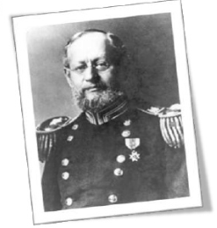
Final Thoughts & Questions
Where there is no law,
but every man does what is right in his own eyes,
there is the least of real liberty.
Henry M. Robert

Slide 38
Questions & Issues for
Robert’s Rules Demystified II
Subsidiary Motions
Incidental Motions
Election Tips
How to Challenge a Chair’s Error?
Best Practices in the Keeping of Minutes
Other Issues?
38

